Slide 1
Analysis of Online Users’ Sequential Click Stream Data Evidence from MSNBC
2175-INSY 5377 WEB & SOCIAL ANALYTICS

Slide 2
Members
Course Instructor:
Dr. Jie Jennifer Zhang
Team: J-PAAC
Abishek Ganesh
Akanksha Shrivastava
Caston Fernandes
Jie Zhang
Padmavathi Karunaiananda Sekar

Slide 3
Clickstream
Clickstream Data
Clickstream Analytics
Two levels: Traffic & E-commerce Analytics
Advantages of using Clickstream Data

Slide 4
Streaming
Analytics
Notifications & Alert
Clickstream
Spark
Storm
KCL
APIs
Dashboards/
Visualization
Batch
Batch
Analytics
Dashboards/
Visualization
DW
Hadoop
Data Archive
Deep Learning
Real Time
Figure 01: Clickstream

Slide 5
Scope
Analyse the detailed path/interaction sequences that users take on msnbc.com website to mine insights from the digital analytics data that helps to create true competitive advantage. Also implement Social Network Analysis on this data to better understand the interaction sequences on the website.

Slide 6
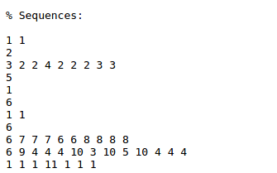
Data Description
Code | Page
1 | frontpage
2 | news
3 | tech
4 | local
5 | opinion
6 | on-air
7 | misc
8 | weather
9 | msn-news
10 | health
11 | living
12 | business
13 | msn-sports
14 | sports
15 | summary
16 | bbs
17 | travel
Source: http://archive.ics.uci.edu/ml/datasets/msnbc.com+anonymous+web+data
Data for September 28, 1999
Sequences:
Number of users: 989818
Average number of visit per user: 5.7
Dataset Characteristics: Sequential
Attribute Characteristics: Categorical
Figure 02: Dataset Snapshot
Table 01: Page Encoding

Slide 7
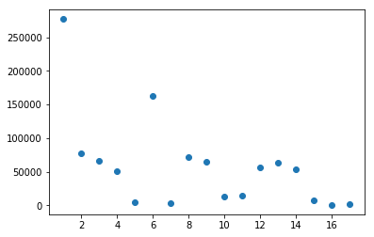
Data Analysis
Landing Page:
Figure 03: Landing Page Frequency

Slide 8
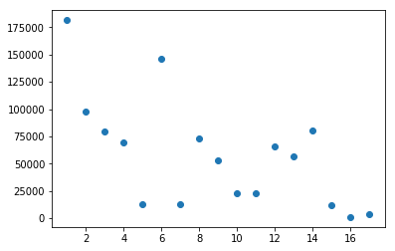
Data Analysis
Exit Page:
Figure 04: Exit Page Frequency

Slide 9
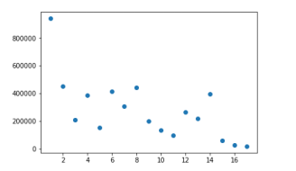
Data Analysis
Maximum & Minimum Page Views:
Figure 05: Maximum Pageviews

Slide 10
Figure 06: Exit Rate Distribution

Slide 11
Figure 07: Bounce Rate Distribution

Slide 12
Pages
Page count in millions
Figure 08: Page Count Distribution

Slide 13
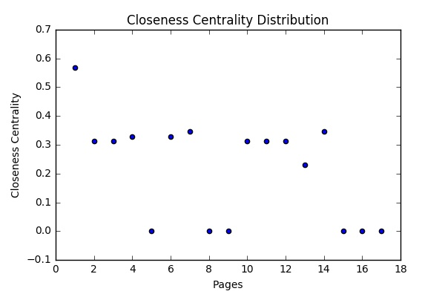
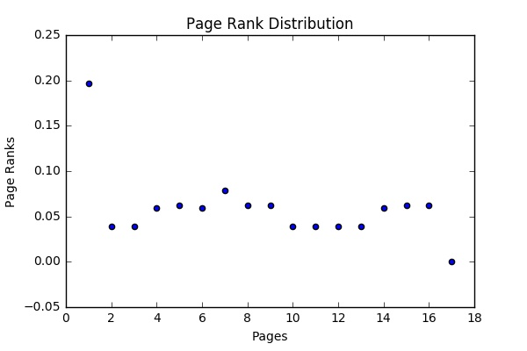
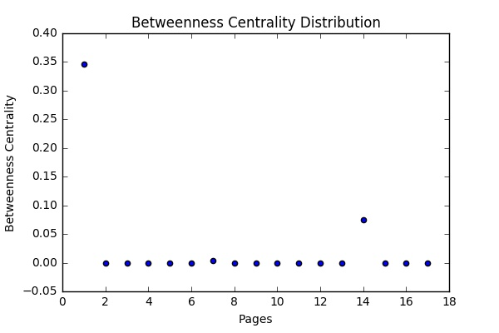
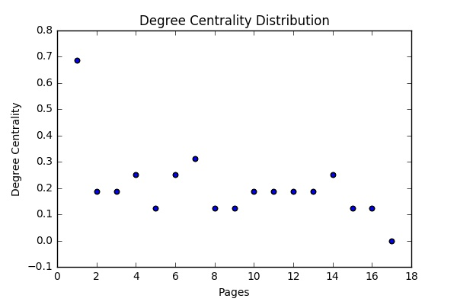
Figure 10: Betweenness Centrality Distribution
Figure 09: Degree Centrality Distribution
Figure 12: Page Rank Distribution
Figure 11: Closeness Centrality Distribution

Slide 14
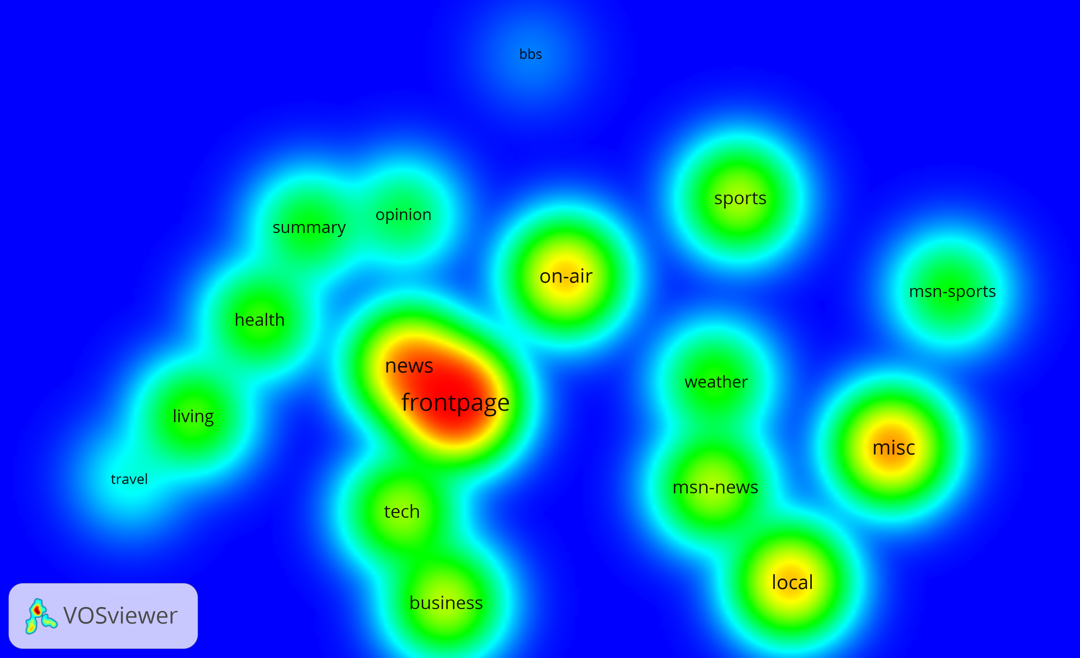
Figure 13: Density graph of the Dataset

Slide 15
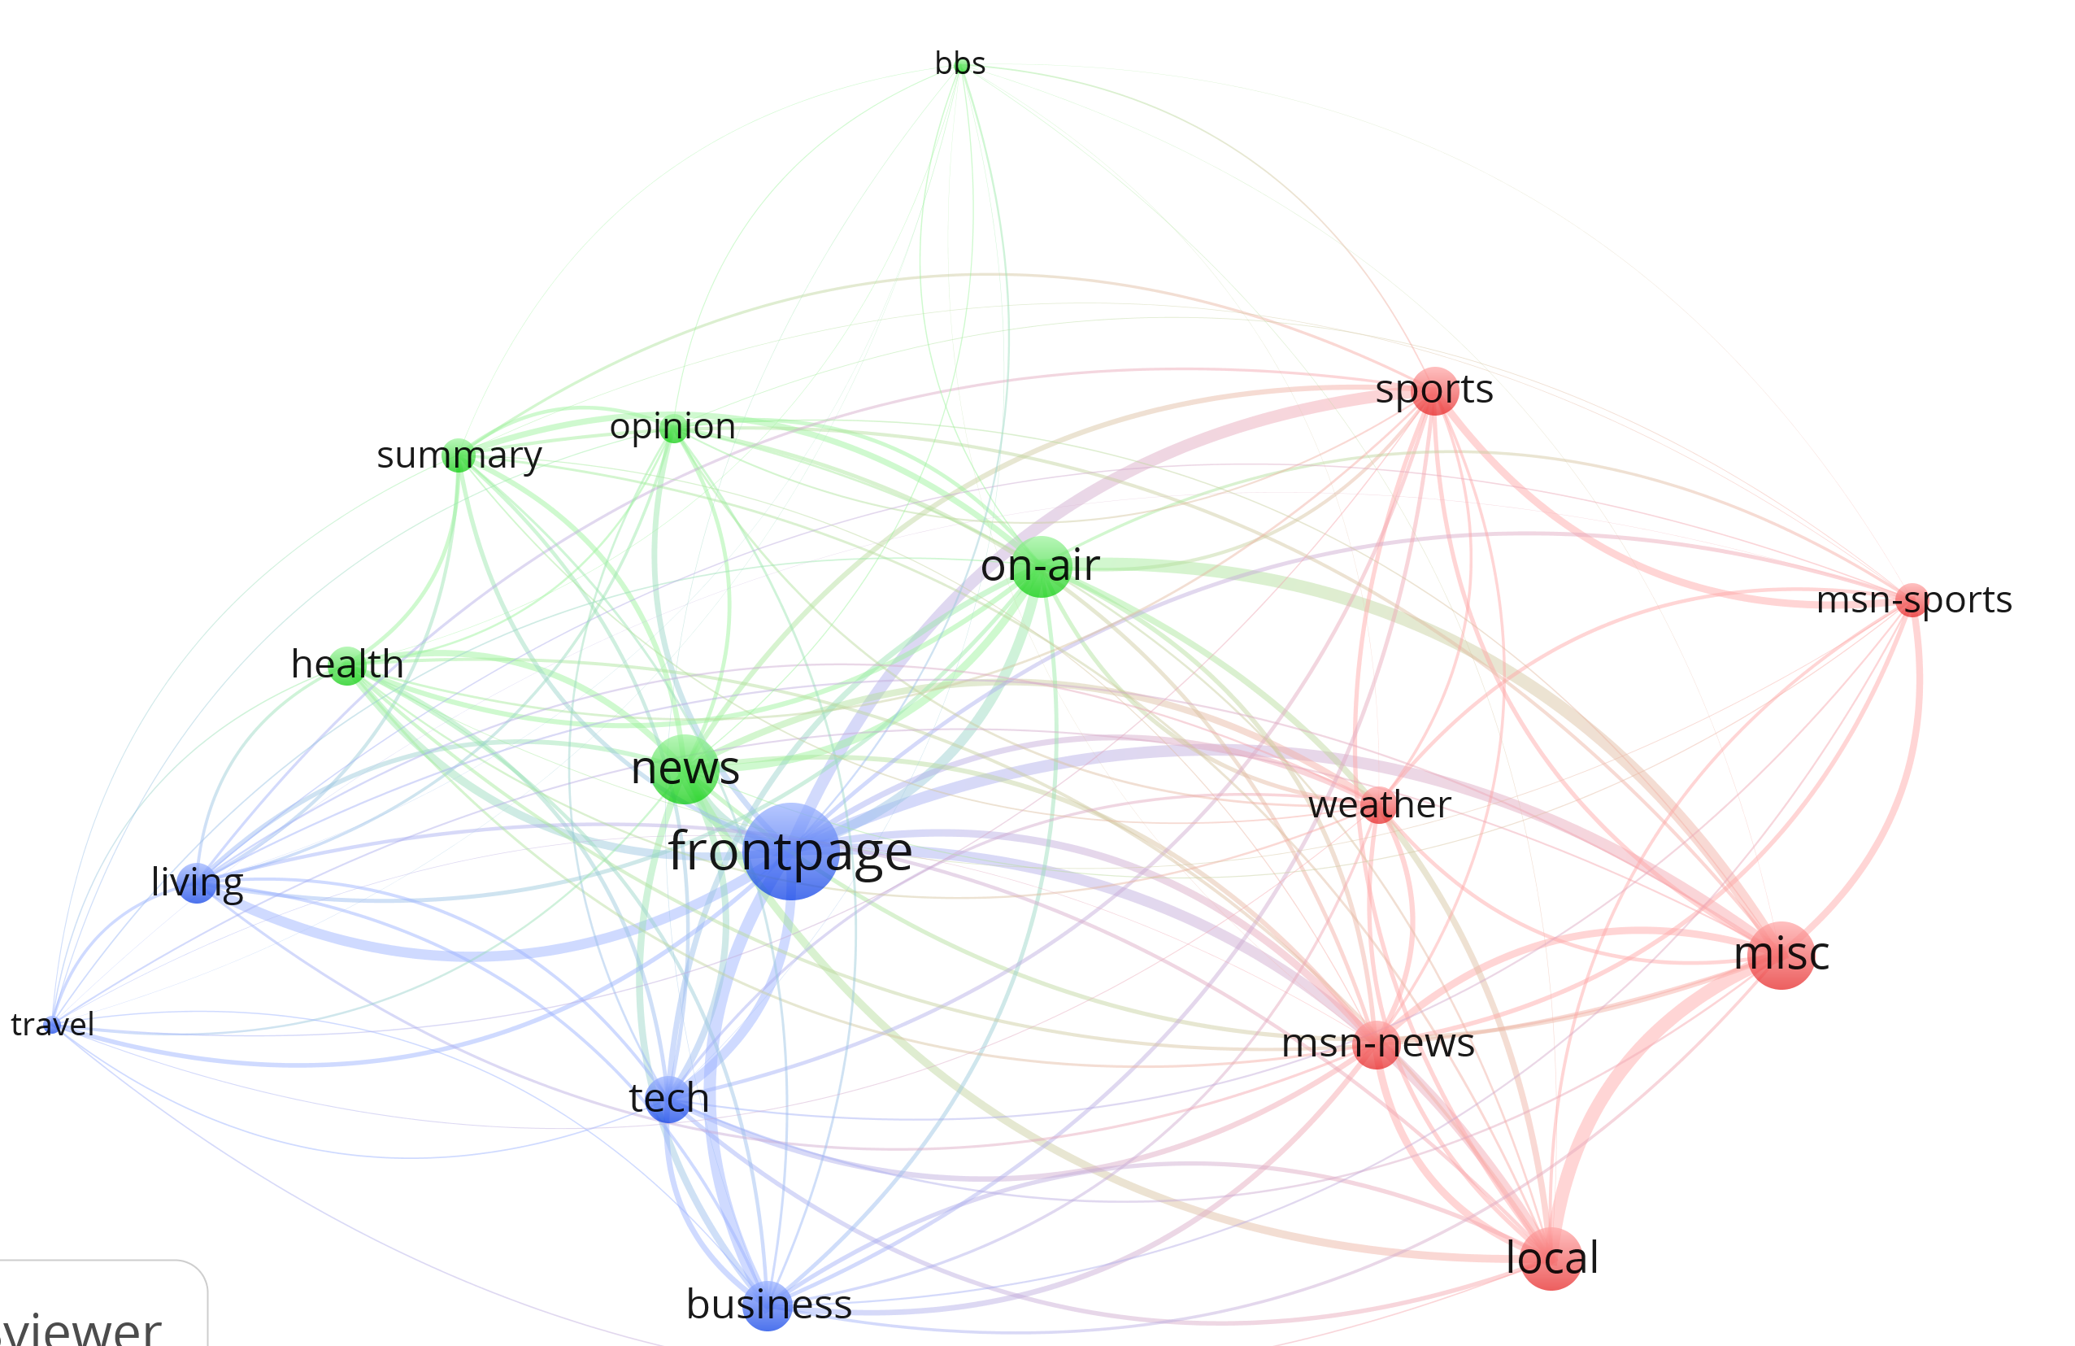
Figure 13: Dataset Network Link

Slide 16
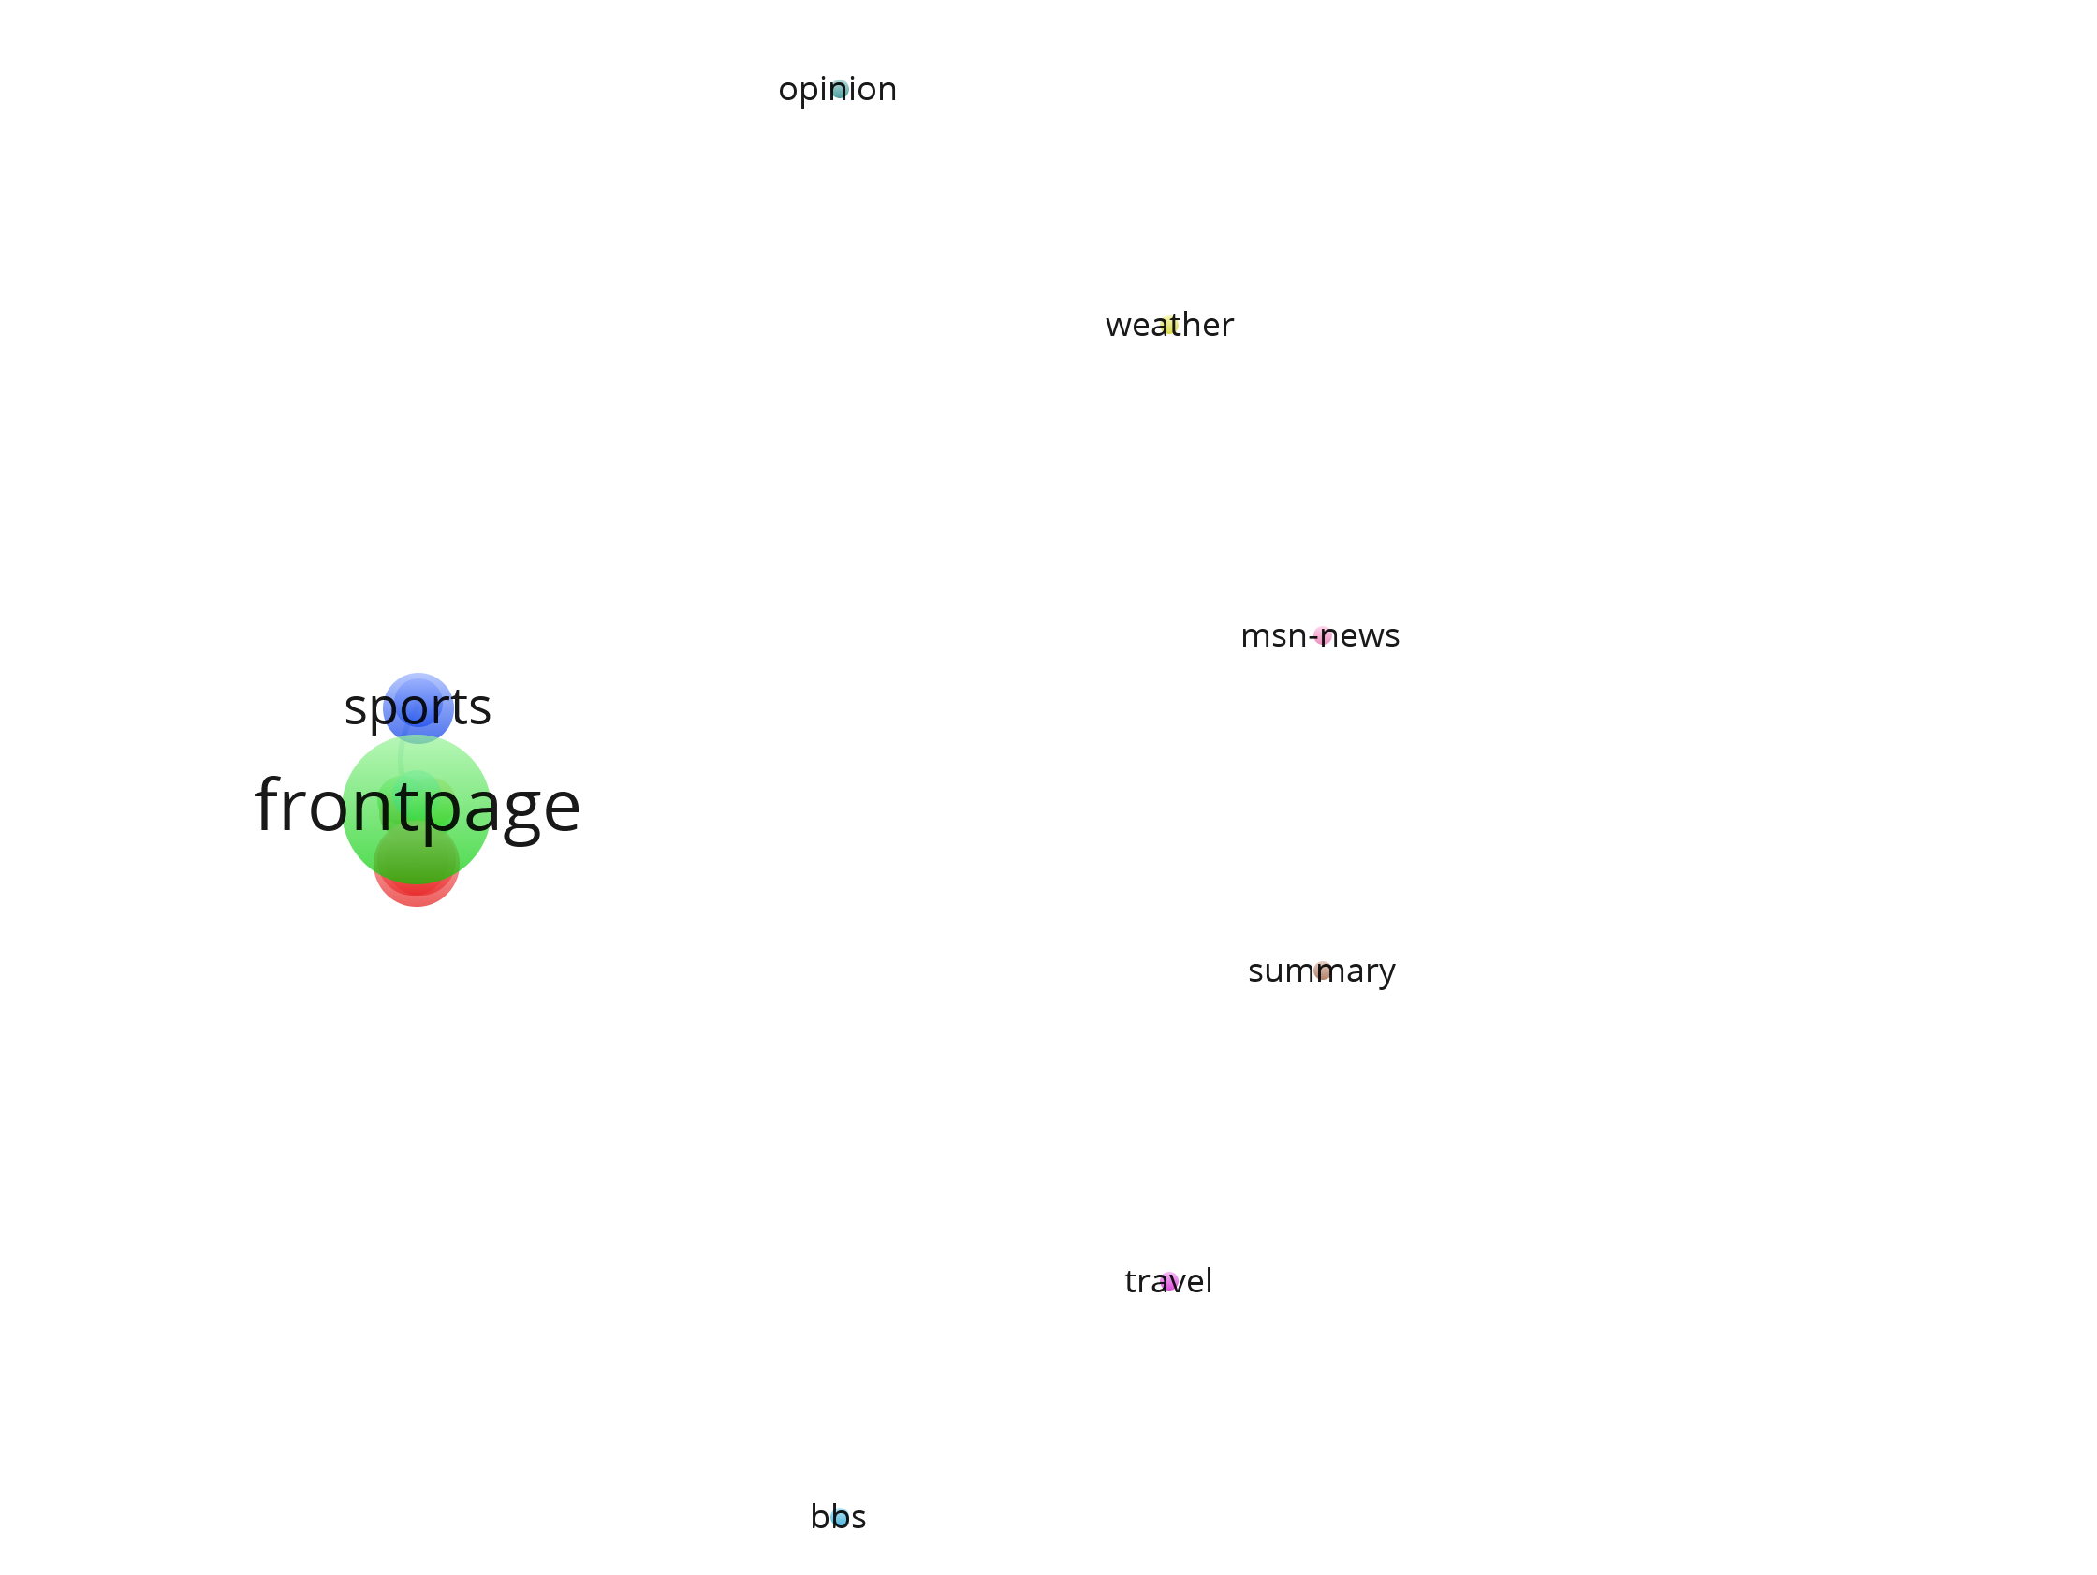
Fig 14: Network link showing position
of all nodes after applying threshold

Slide 17
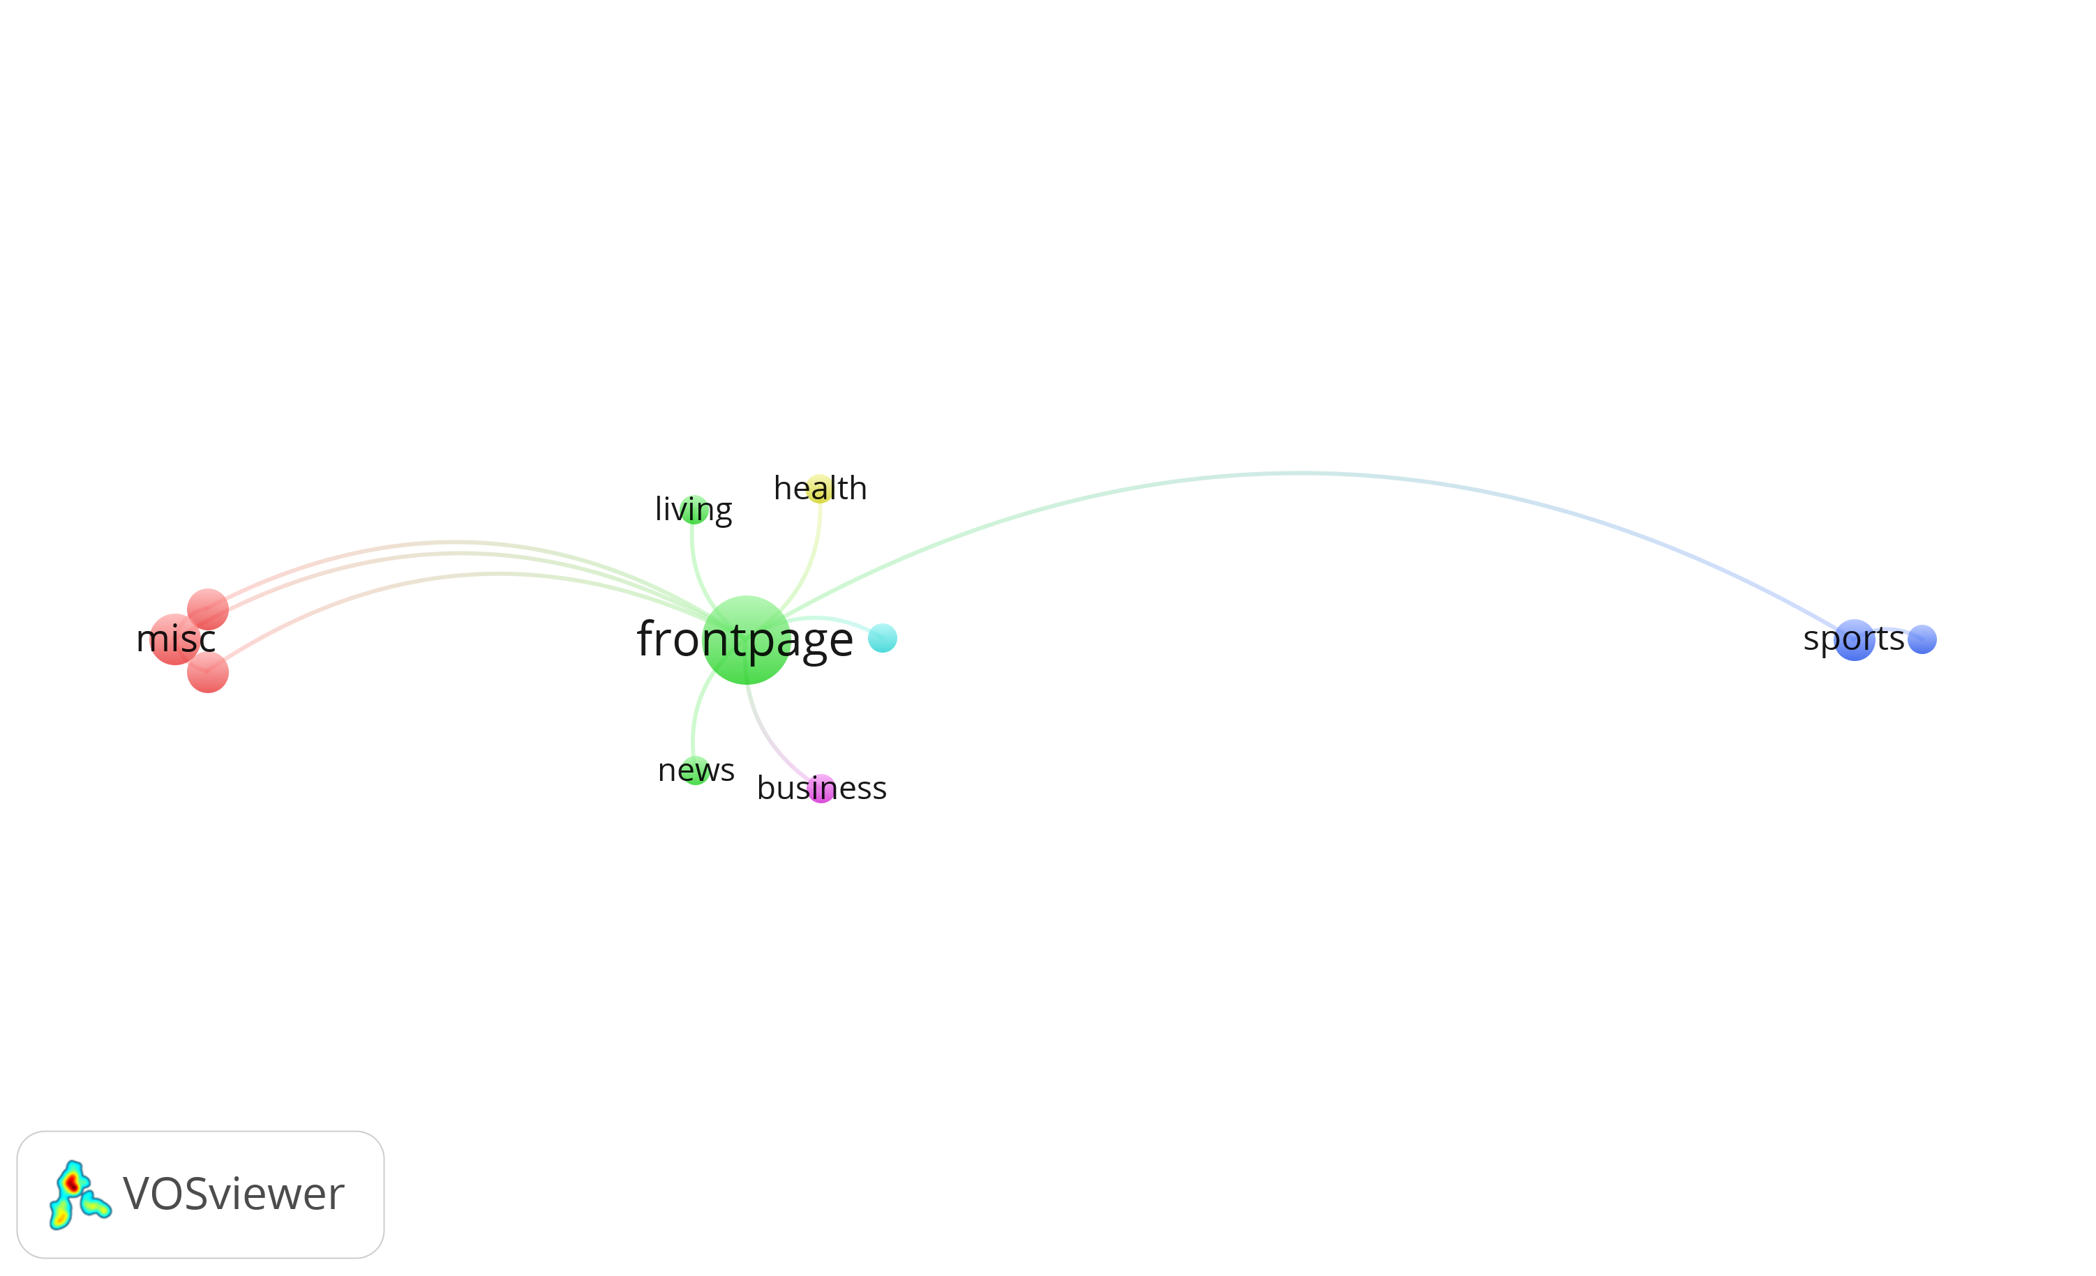
Fig 15: Network link showing connected nodes after applying threshold

Slide 18
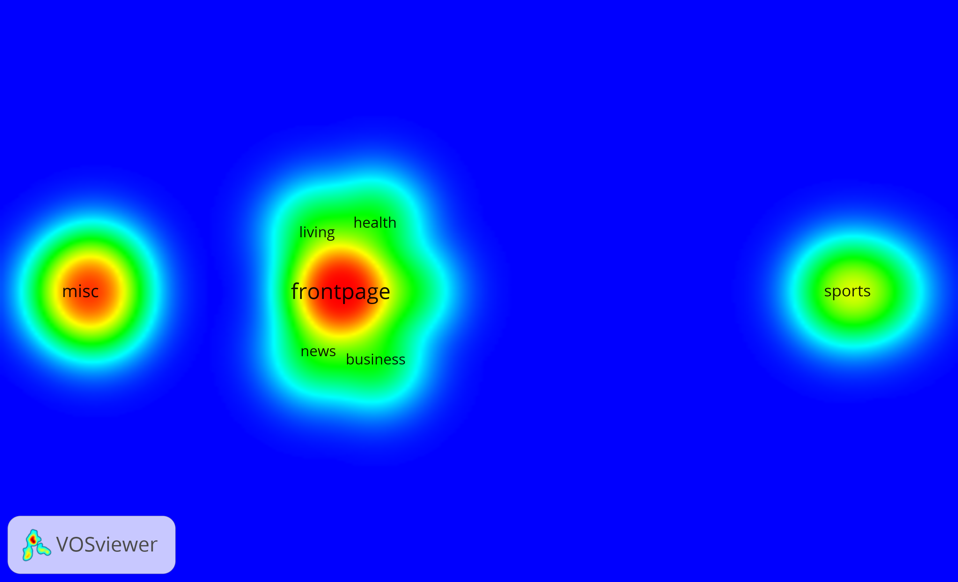
Fig 17: Density graph showing connected nodes after applying threshold

Slide 19
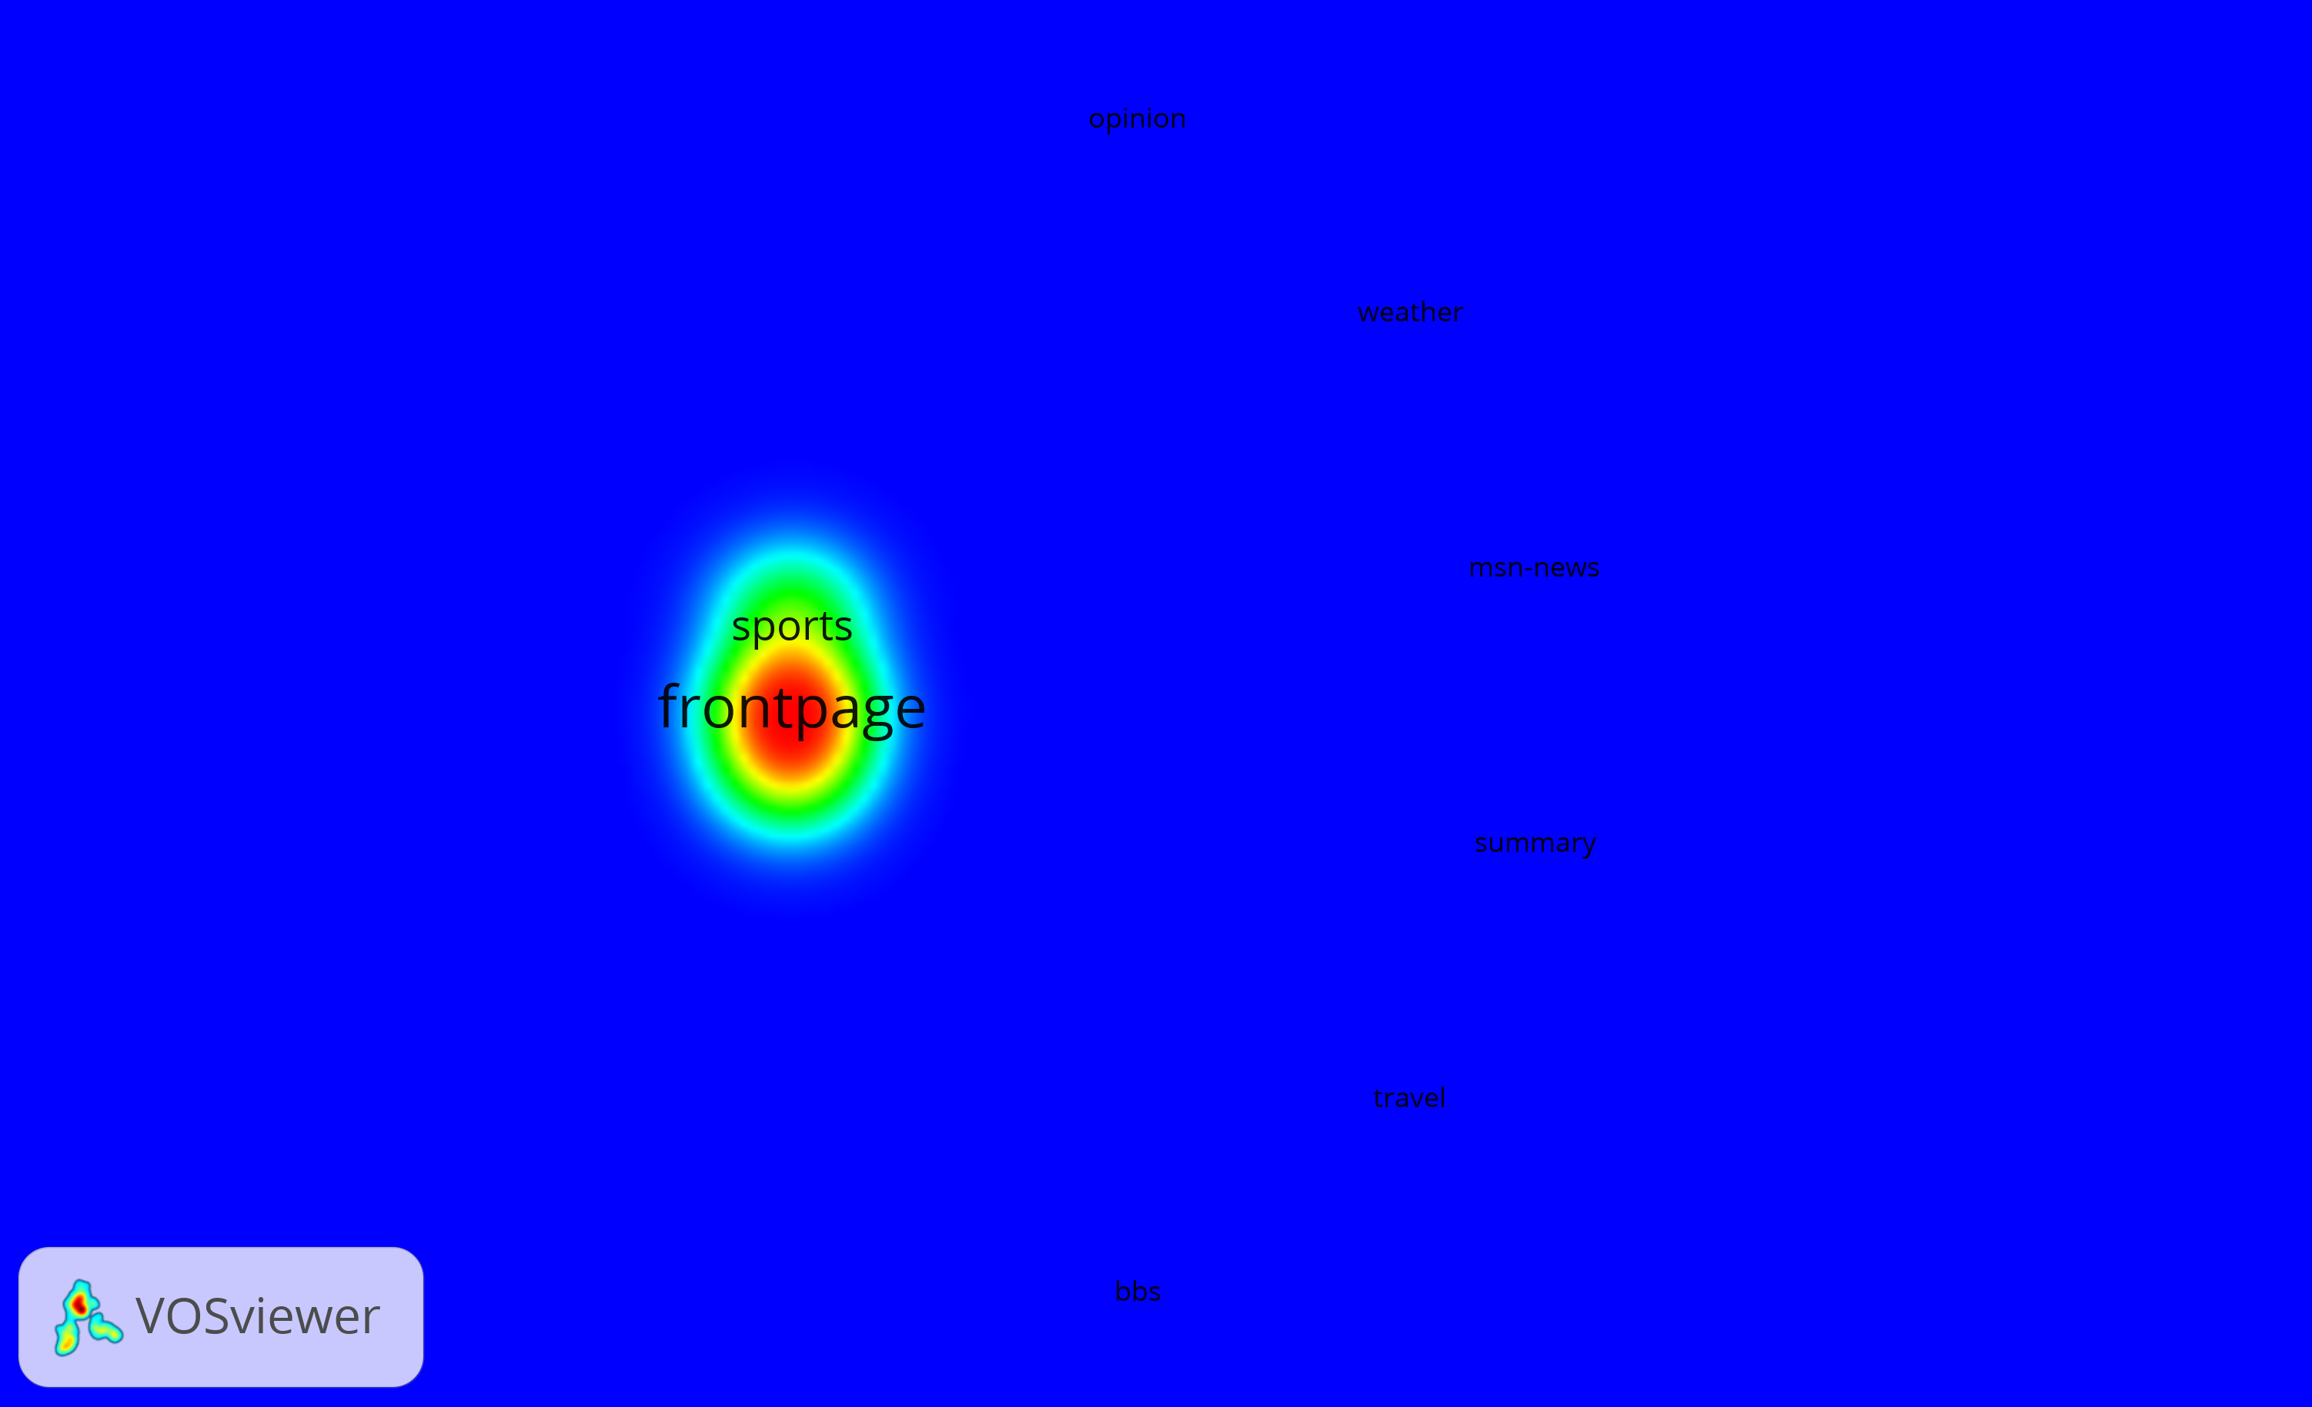
Fig 18: Density graph showing position of all nodes after applying threshold

Slide 20
Recommendation

Slide 21
Recommendation for Seq of 2, 5 |  | Recommendation for Seq of 6, 5
('2', '5', '5') | 1328 | ('6', '5', '5') | 1172
('2', '5', '2') | 469 | ('6', '5', '6') | 323
('2', '5', '6') | 172 | ('6', '5', '8') | 234
('2', '5', '1') | 160 | ('6', '5', '2') | 164
('2', '5', '3') | 62 | ('6', '5', '1') | 113
('2', '5', '15') | 62 | ('6', '5', '11') | 67
('2', '5', '12') | 53 | ('6', '5', '15') | 65
('2', '5', '8') | 49 | ('6', '5', '10') | 61
('2', '5', '11') | 48 | ('6', '5', '16') | 42
('2', '5', '10') | 47 | ('6', '5', '7') | 40
('2', '5', '14') | 35 | ('6', '5', '3') | 35
('2', '5', '4') | 33 | ('6', '5', '12') | 32
('2', '5', '7') | 20 | ('6', '5', '14') | 23
('2', '5', '9') | 17 | ('6', '5', '4') | 21
('2', '5', '17') | 7 | ('6', '5', '9') | 13
('2', '5', '16') | 6 | ('6', '5', '17') | 6
('2', '5', '13') | 4 | ('6', '5', '13') | 2
Table 02: Page Recommendations

Slide 22
Conclusion

Slide 23
Challenges Faced
Only Categorical Data
Data limited to a day
No information about users and their activity
Assumption: Normal data distribution
Lessons Learned
Web Analytics Concepts & Metrics
Social Analytics concepts
Recommending pages
Tools for Network Analysis

Slide 24
Thank You!!!

